Slide 1
Seminar Design: Therapeutic Effects of Psychedelics
Spring 2019

Slide 2
Have Fun
Please!
Ps. Eating relieves stress

Slide 3
Set up – use PowerPoint
Naming your PowerPoint
FirstnameYearSeminarname.pptx
Cliff19Therapeutic Effects of Psychedelics.pptx
just 19, not 2019

Slide 4
Present 3 Papers
Start looking in the first week
Send them to me early
Topic Paper
The Focus of your presentation
2 Background Papers
No reviews

Slide 5
Set up - details
Topic Paper (lots of graphs/not review)
Published within the last 2 years
Animal Models are easier
2 Background Papers - Can be older
Help tell the scientific story
Still want graphs
just use the ones that help explain
Really! No reviews

Slide 6
Methods
Animal models vs Human Studies
fMRI
voxel pictograms
vs graphs

Slide 7
SEND IT EARLY
Topic Paper – 3 weeks ahead
Background papers – 2 weeks
Use PowerPoint
Full draft – 1 week ahead
Final version – 2 days ahead

Slide 8
Tell a Story!

Slide 9
Font Size
This font is too small (18 pt)
May come with the PowerPoint design
This font is too small (20)
24, 28, 32
32 is just right!

Slide 10
Speaking to a Group
Delivery
Presentation not Read
Slides have bullet points
Not sentences

Slide 11
Tell a Story!
A Story has
1. beginning
2. middle
And an
3. end

Slide 12
Tell a Story!
In the Beginning
Introduce the characters
Scientific Characters are
usually Ideas
Tell what the problem is
Tell what is known so far

Slide 13
Tell a Story!
use the Background Papers
To tell the story, to…
Explain why we care
why is it important
Tell what isn’t known

Slide 14
Introduction
Background Story
Background Material Enhances
Group understanding
Tell us what isn’t known!
Why is it important
Woven into Larger Story
Purpose of Research
clearly explained

Slide 15
The Middle might be boring
Methods and Results
Why the methods
solve the problem
Connect each Result
With the Ideas
from the Beginning
With other Results

Slide 16
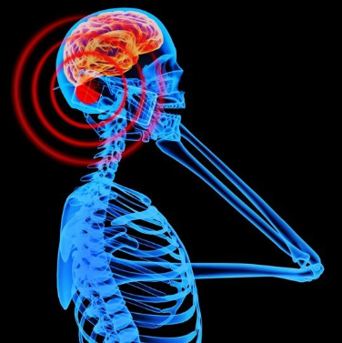
Methods
Delivery is enhanced by
Clear Visuals
Advanced Techniques explained
Why the Techniques are Used
Why they solve the problem

Slide 17
The Middle might be boring
Tell the Story of the Results
In a Logical Order
Your job is to: Logically
Impel the Narrative
make the story move forward

Slide 18
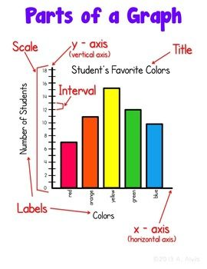
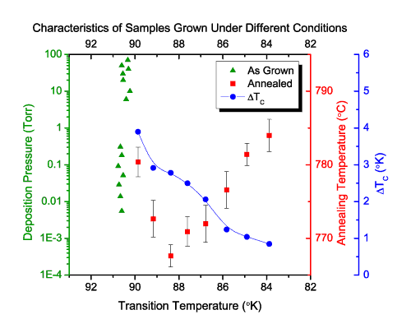
Graphic Results
used and explained clearly
Clear Visuals
Choose papers with lots of graphs
but only use ONE per slide

Slide 19
Results Clear Visuals
Get graphs
from the official journal website
don’t use the .pdf graphs
can be grainy

Slide 20
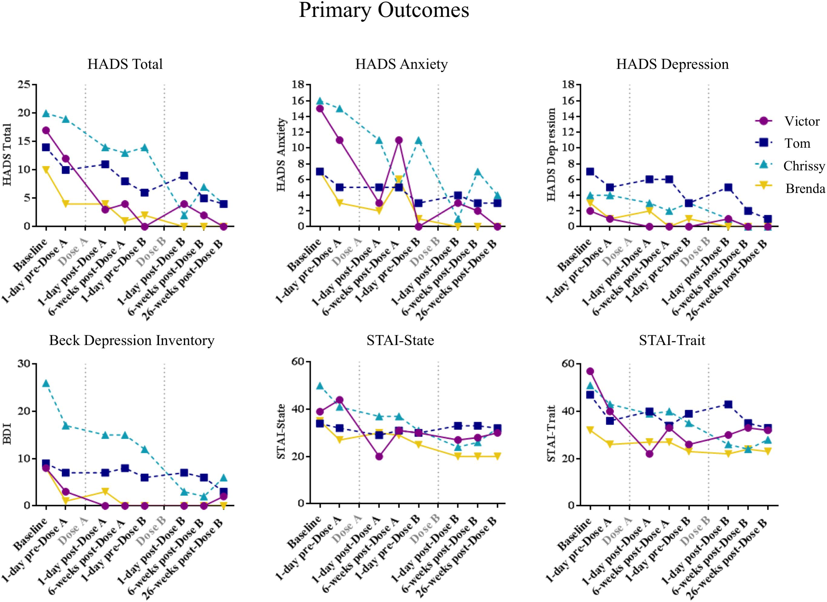
Practical Tip
1 Graph/Slide Clear Visuals – crop tool

Slide 21
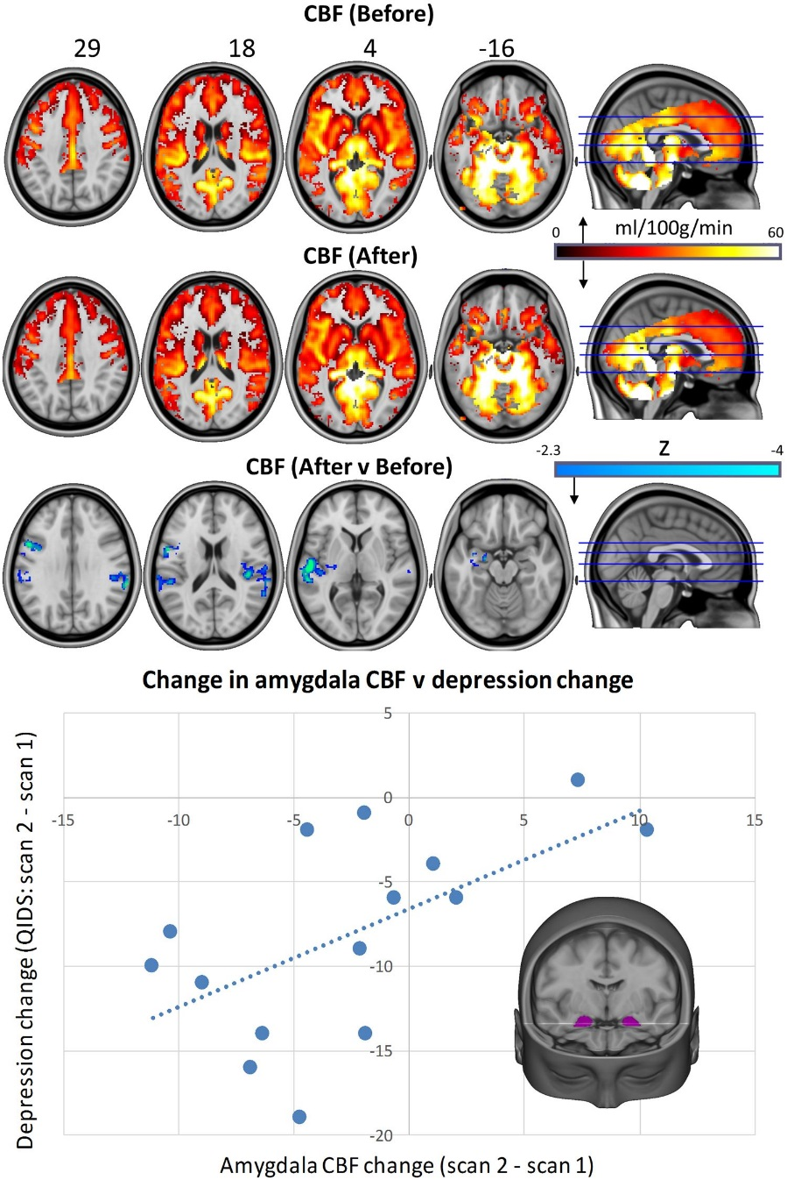
Practical Tip
1 Graph/Slide Clear Visuals

Slide 22
The End – What is a Discussion?
A Linear Narrative
ends with a Climax
fed from the beginning
List Original Ideas
Are they still valid?
Explain Ideas/Results
in relation to the problem

Slide 23
The End – What is a Discussion?
Explain Ideas/Results
in relation to other student’s notions
of the problem or solution
Interactive Presentation
Drive the Discussion
Discuss the Next Step
Is there a new problem?

Slide 24
Discussion
Take Home Messages
Clearly Outlined
Analysis of Scientific Value of each idea
Integration of ideas into a story
Background & Topic Papers
Messages interwoven
Discussed together
Stimulated Group Discussion

Slide 25
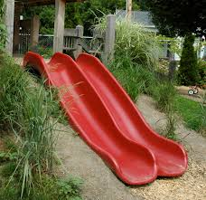
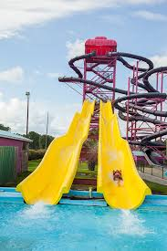
End at about 65
Slides that is
Not an Absolute, but…
About 65 slides
per Presentation
Us, having fun, with 65 slides

